Slide 1

Just Travelous
Log in
Sign up
Where are you going | When | Guests | Price | Search

Slide 2
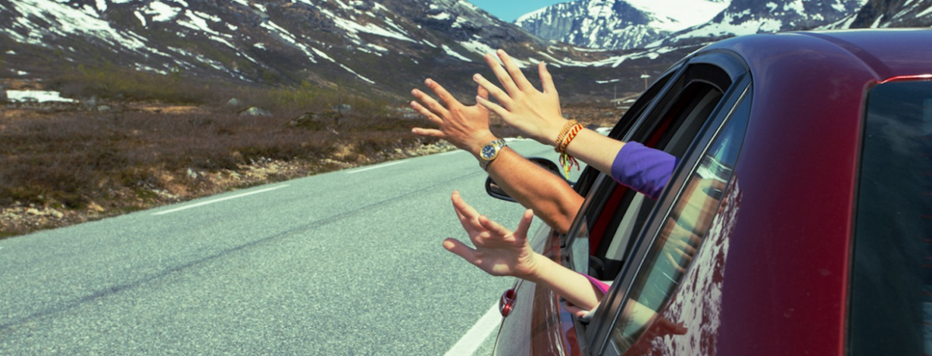
Flights | Buses | Trains | Hotels
Offers for you
Get 20% off*
On Flights, Hotel & Bus Bookings
Code: EXCLUSIVE
Trip Ideas

Slide 3
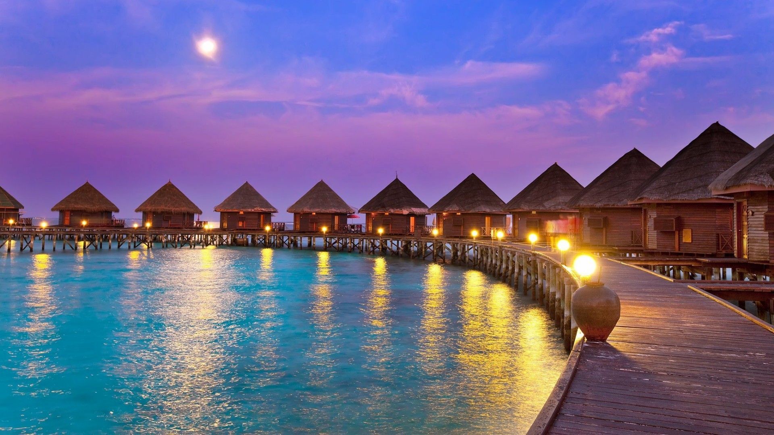
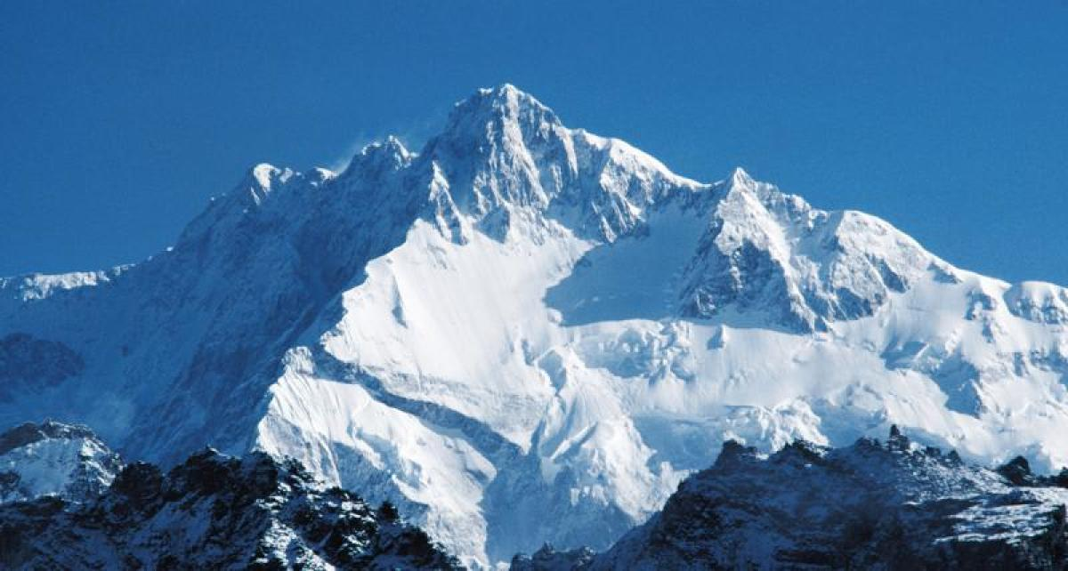
When we scroll down our home page
Popular tour in the season
Maldives
2 reviews
from 80,000
Jammu n Kasmir
5 reviews
from 50,000
…………………………
Covid Guidelines

Slide 4




Get updates & more Your email
SUBSCRIBE
Need Help?
Call us
6768676776
Email us
Justtravelous@gmail.com
Follow us
Settings
Currencies
EUR

Slide 5

Inside the search bar
Search
Our services
History
…………….
………………..
………………….
………………..

